Slide 1
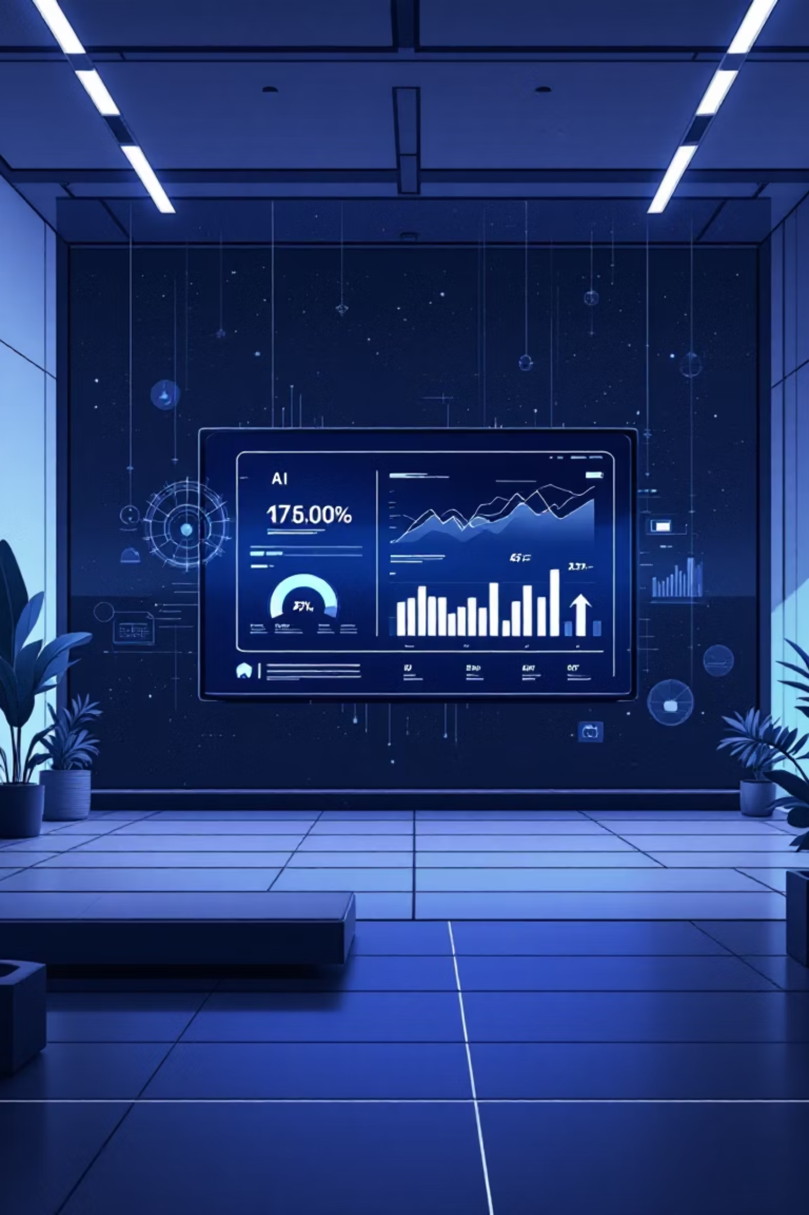
AI-Powered Customer Segmentation & Intelligence System
A concise pitch deck: Problem → Solution → Process → Impact → Future Vision. Designed for technical and business stakeholders.

Slide 2
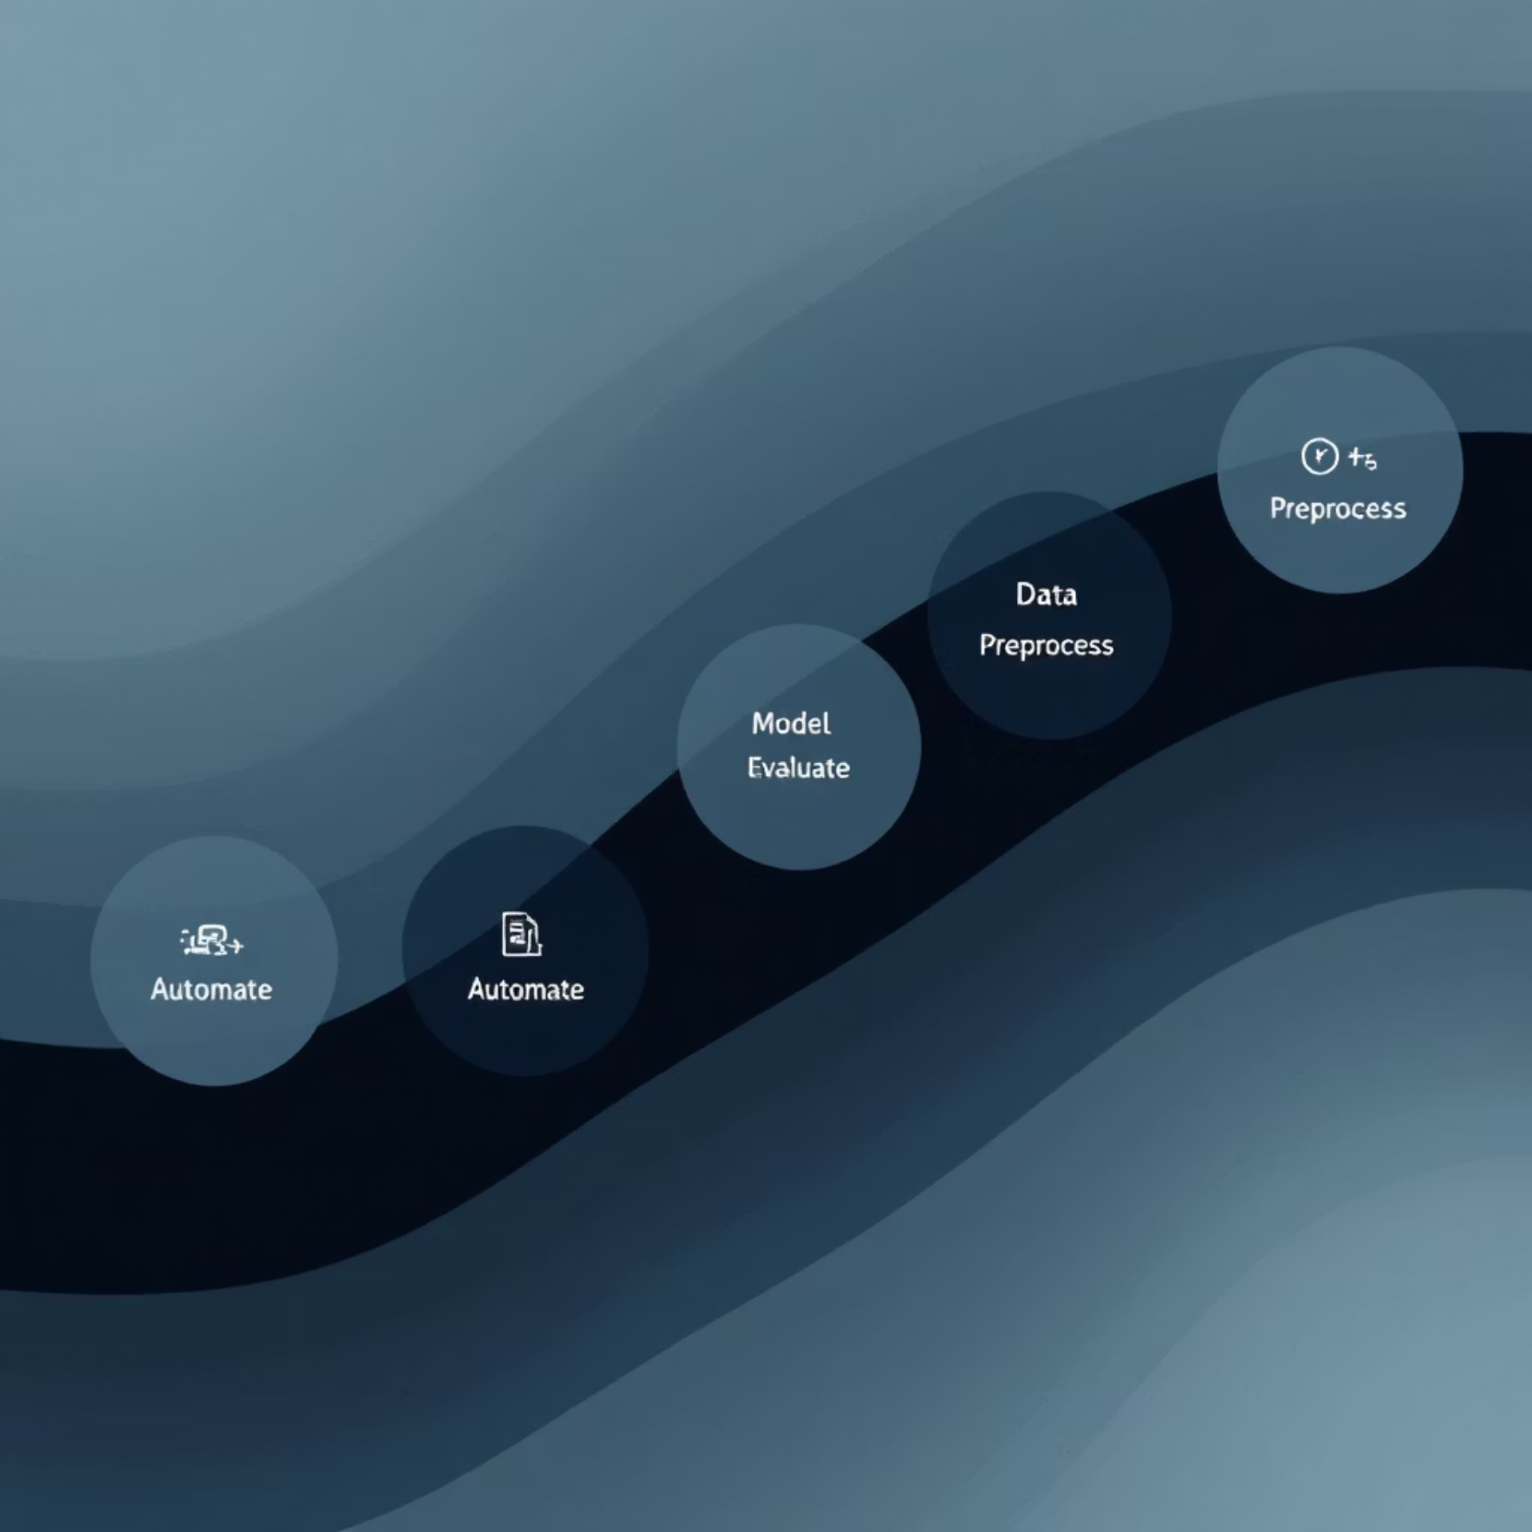
Storyline & Agenda
Deck Flow
Problem: fragmented customer data
Solution: unified AI-driven segmentation
Process: 5-phase delivery
Impact: measurable marketing lift
Vision: cloud-native intelligent platform

Slide 3
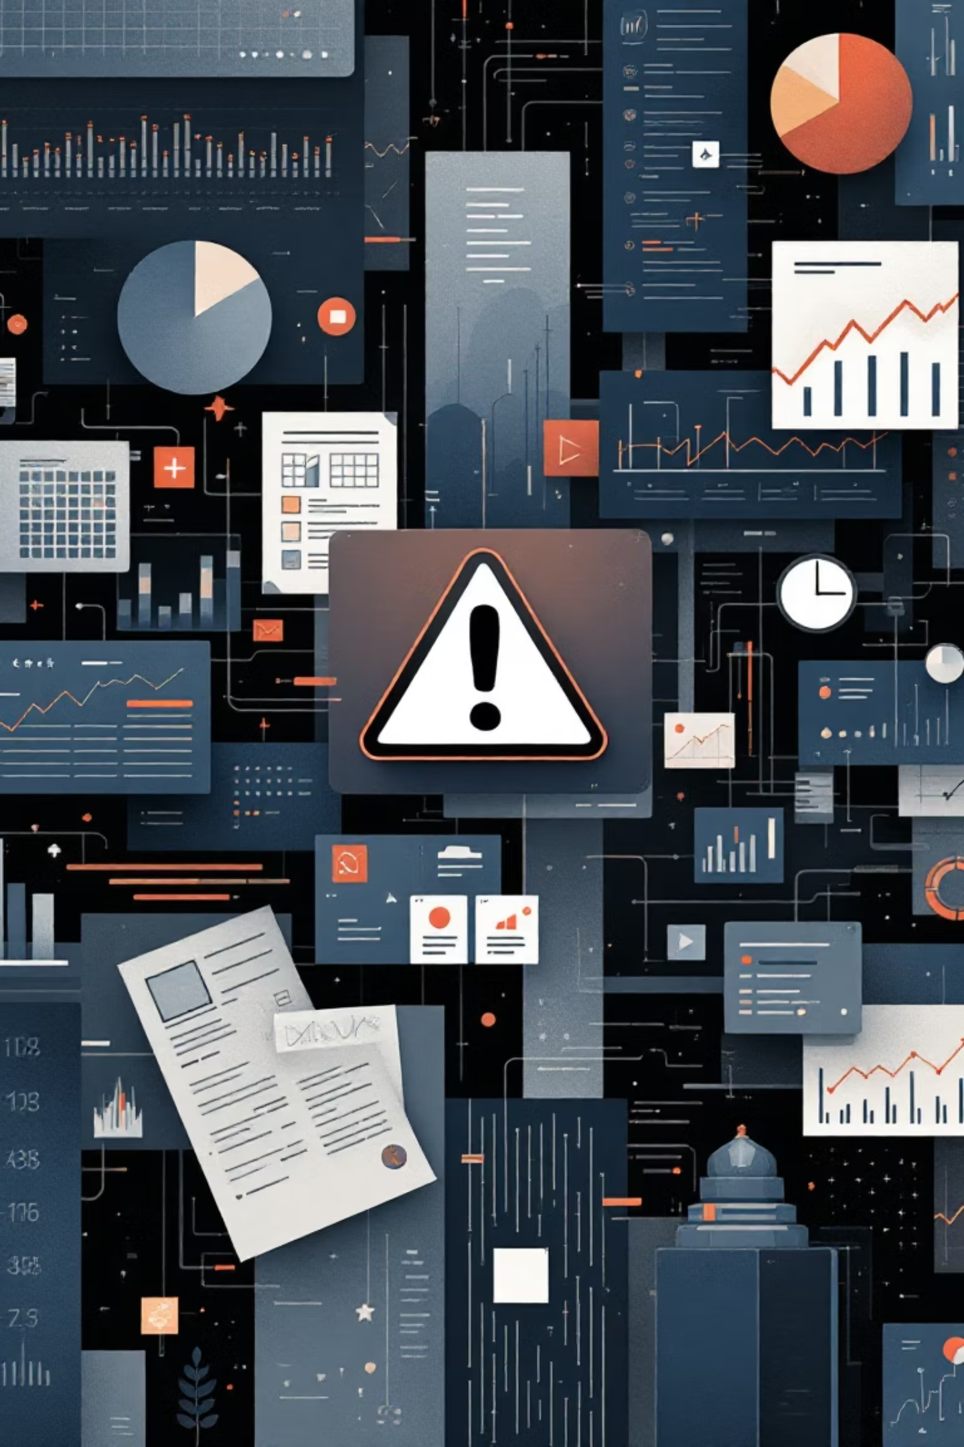
Problem — Data Chaos
Objective
Main Issues
Gather and unify customer data from all sources to create a single source of truth.
Siloed transaction, behavior, and demographic data
Inconsistent formats, duplicates, missing values
Delayed updates prevent real-time action
Add-ons
Connect automated data pipelines for continuous ingestion and validation.

Slide 4

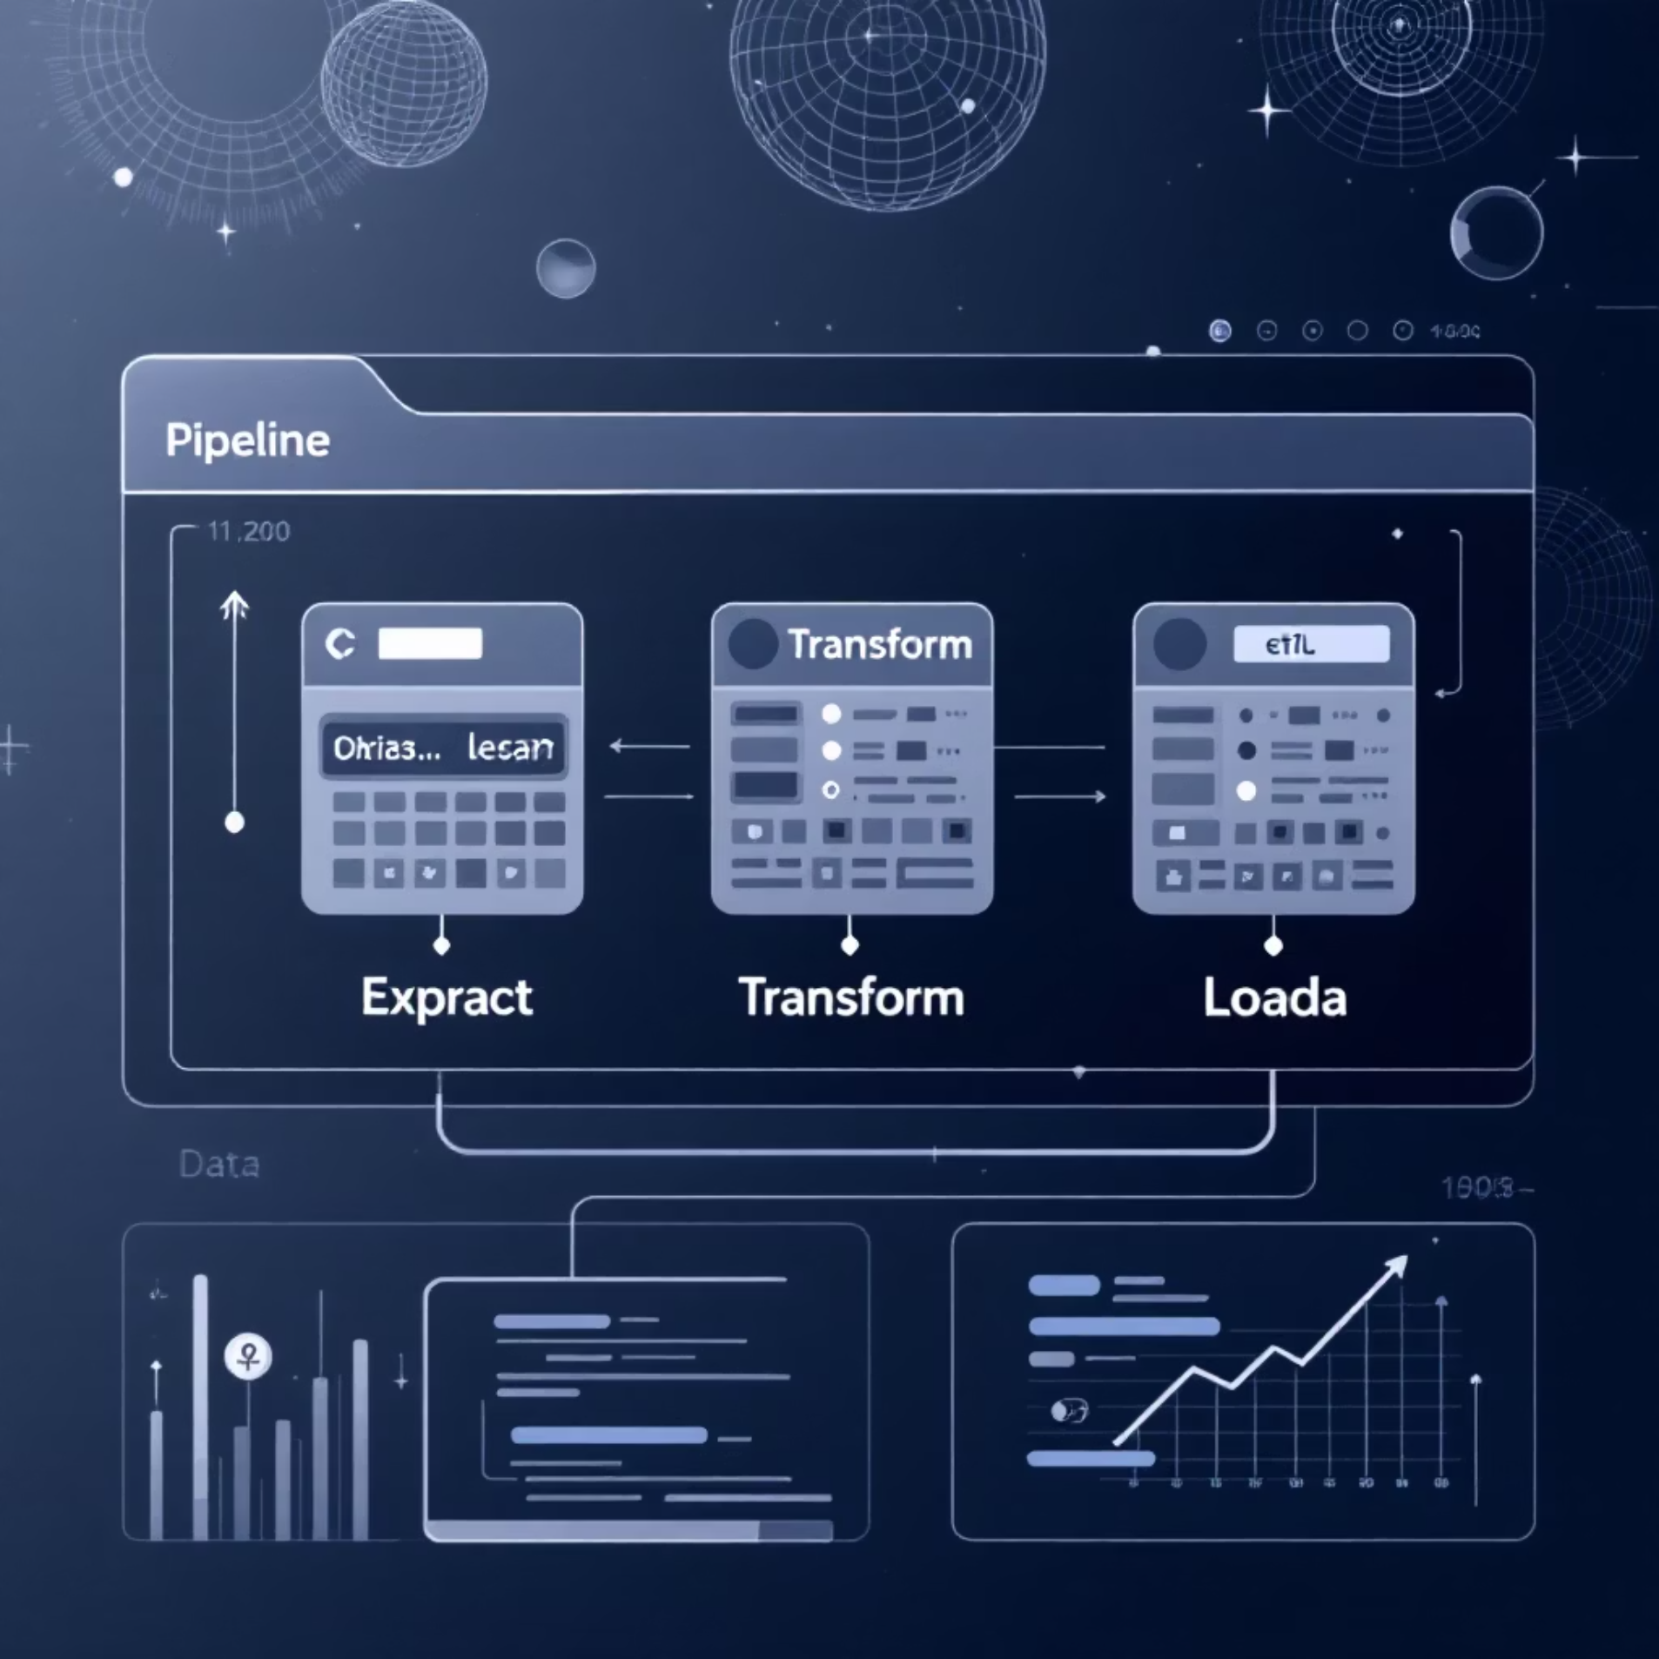
Phase 1 — Data Collection
Objective
Assemble raw customer data across systems into a unified dataset.
Key Tasks
Collect transactions, demographics, behavior logs
Standardize formats and merge sources
Run validation checks to ensure quality
Add-ons
Automated pipelines for scheduled updates.

Slide 5

Phase 2 — Data Preprocessing
Objective
Prepare high-quality features for ML models.
Tasks
Handle missing values and outliers
Scale numeric features; encode categoricals
Split into training / testing sets
Add-ons
Automated preprocessing scripts to ensure reproducibility.

Slide 6
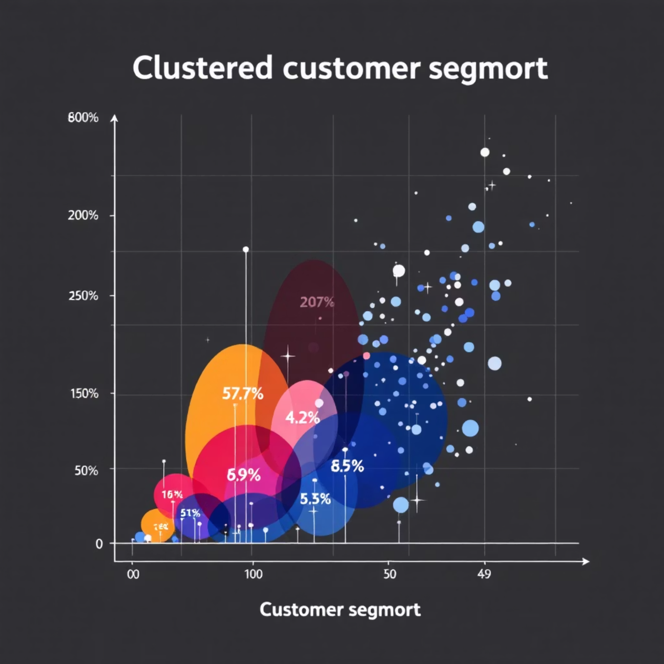

Phase 3 — Machine Learning Model
Objective
Develop clustering and predictive models to segment customers and predict behavior.
Tasks
Run clustering: K-Means, Hierarchical
Tune k-values; evaluate cluster cohesion
Visualize clusters and behavioral patterns
Add-ons
PCA and dimensionality reduction for clearer visualization.

Slide 7
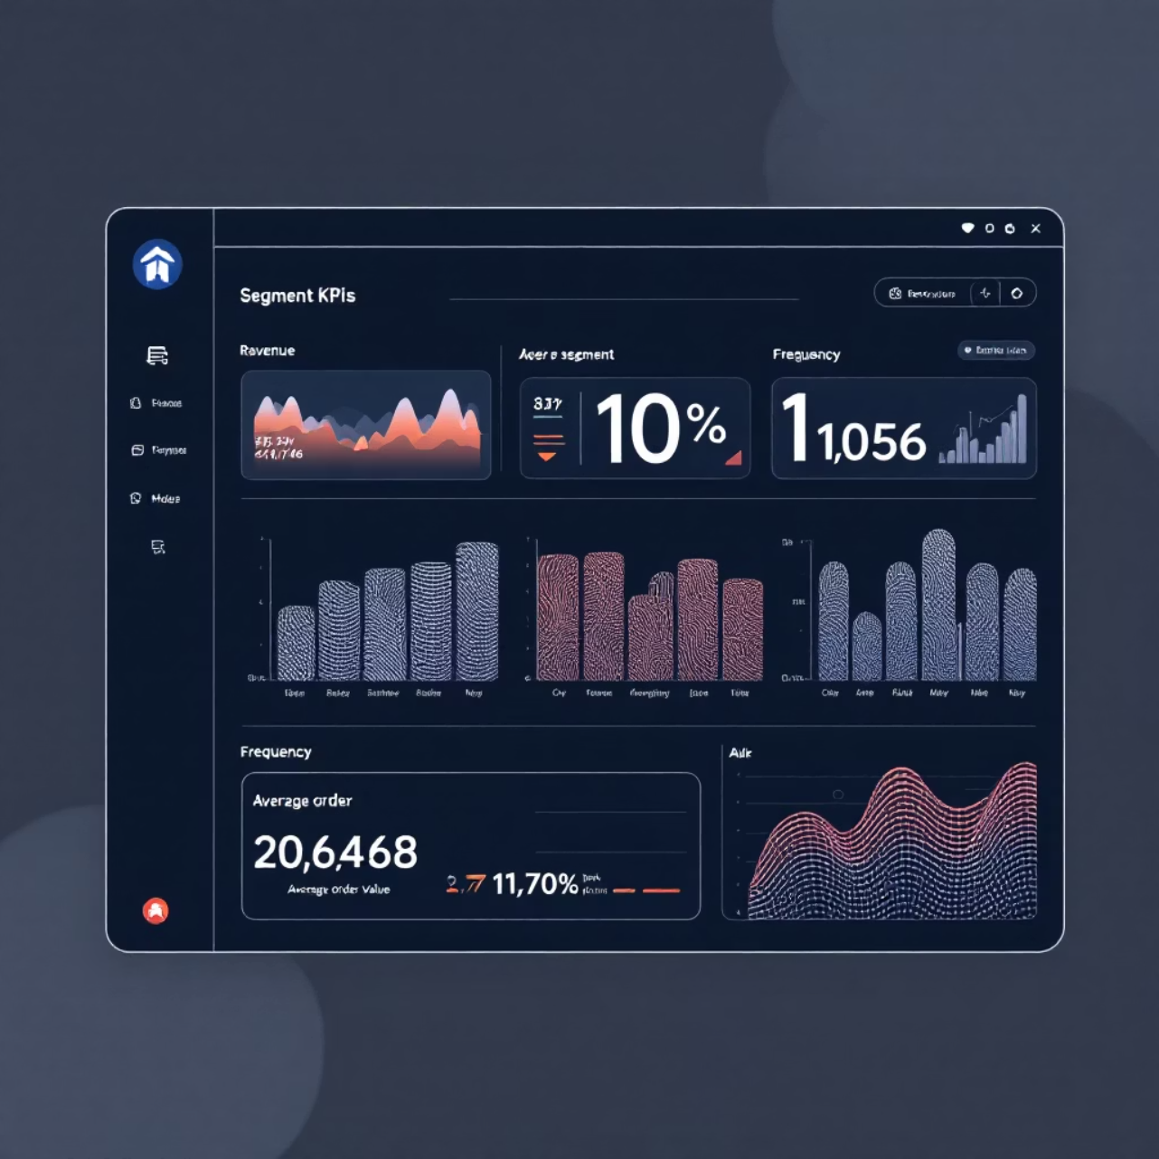
Phase 4 — Evaluation & Insights
Objective
Assess model quality and convert segments into actionable insights.
Tasks
Compute Silhouette and Davies–Bouldin metrics
Analyze segment demographics and purchase behavior
Deliver dashboards for stakeholders
Add-ons
Power BI integration for interactive reporting.

Slide 8
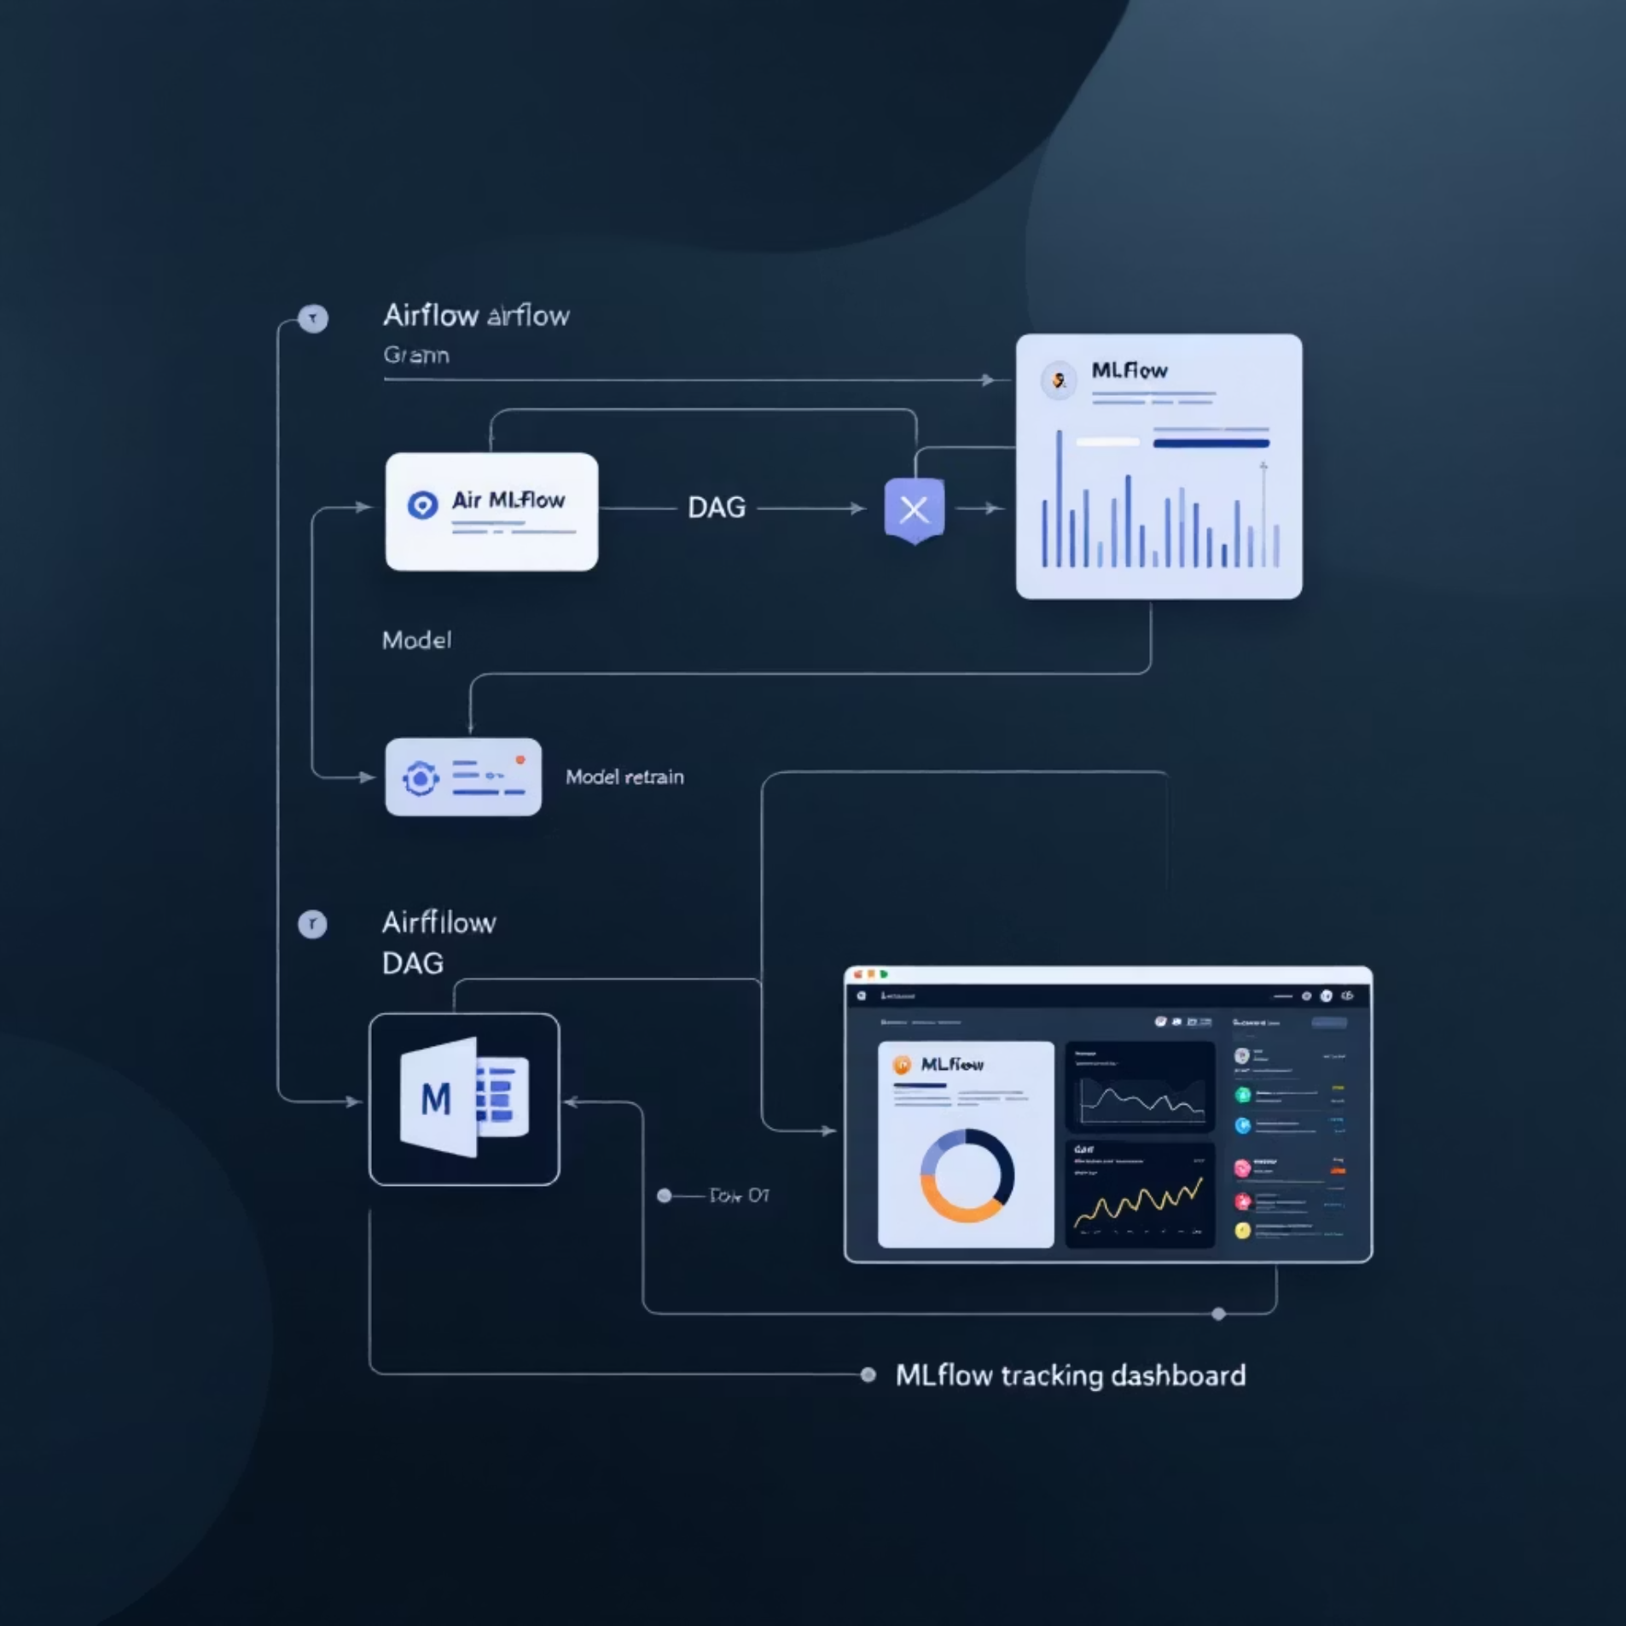

Phase 5 — Automation & Intelligence
Objective
Operationalize a self-learning system that adapts as data changes.
Tasks
Auto-retraining with Airflow triggers
Model tracking and versioning in MLflow
Periodic data updates for near-real-time insights
Add-ons
Smart alerts for KPI drift and automated campaign triggers.

Slide 9

Key Insights & Impact
$1.2M
3x
68%
Incremental Revenue
Engagement Lift
High-Value Segment
Higher CTRs from tailored messaging vs generic campaigns.
Estimated first-year uplift from personalized campaigns.
Portion of customers driving majority of revenue identified.
Auto
Operational Efficiency
Automated retraining and alerts reduce manual overhead.
Other insights: seasonal trends, targeted offers, and prioritized churn-risk segments.

Slide 10

From Data Chaos to Smart Marketing Intelligence
Pitch Summary
Why now: Fragmented data is blocking growth; AI creates precision.
What we deliver: Unified data, validated models, automated intelligence.
Business outcome: Measurable revenue uplift, improved retention, scalable platform.
Next steps: pilot with top 3 segments (30–60 days), integrate CRM triggers, scale to full customer base. Contact: Product & Data Leads for project kickoff.

